Slide 1
South East Region Support offer for Proxy Access to ordering Medication for Residents in Care and Nursing Homes Session 1 - Understanding the DSPT

Slide 2
Session 1 - Data Security and Protection Toolkit
What is the DSPT? Background and Overview
Defining the Starting point
How do I find out what my status is?
What requirements do I need to comply to?
NHS Mail / Waiver
Questions

Slide 3
Session 1 - Data Security and Protection Toolkit
What is the DSPT?
The DSPT is an annual self-assessment for health and care organisations.
It shows you what you need to do to keep people’s information safe, and to protect your business from the risk of a data breach or a cyber attack.
Once you’ve completed the DSPT, it will help you demonstrate to your residents and their families, Commissioners, CQC, GPs and other NHS services, that you are handling information securely.
The DSPT is a requirement for Digital Access for patient care and is a driver for implementation of Proxy Access for ordering medication

Slide 4
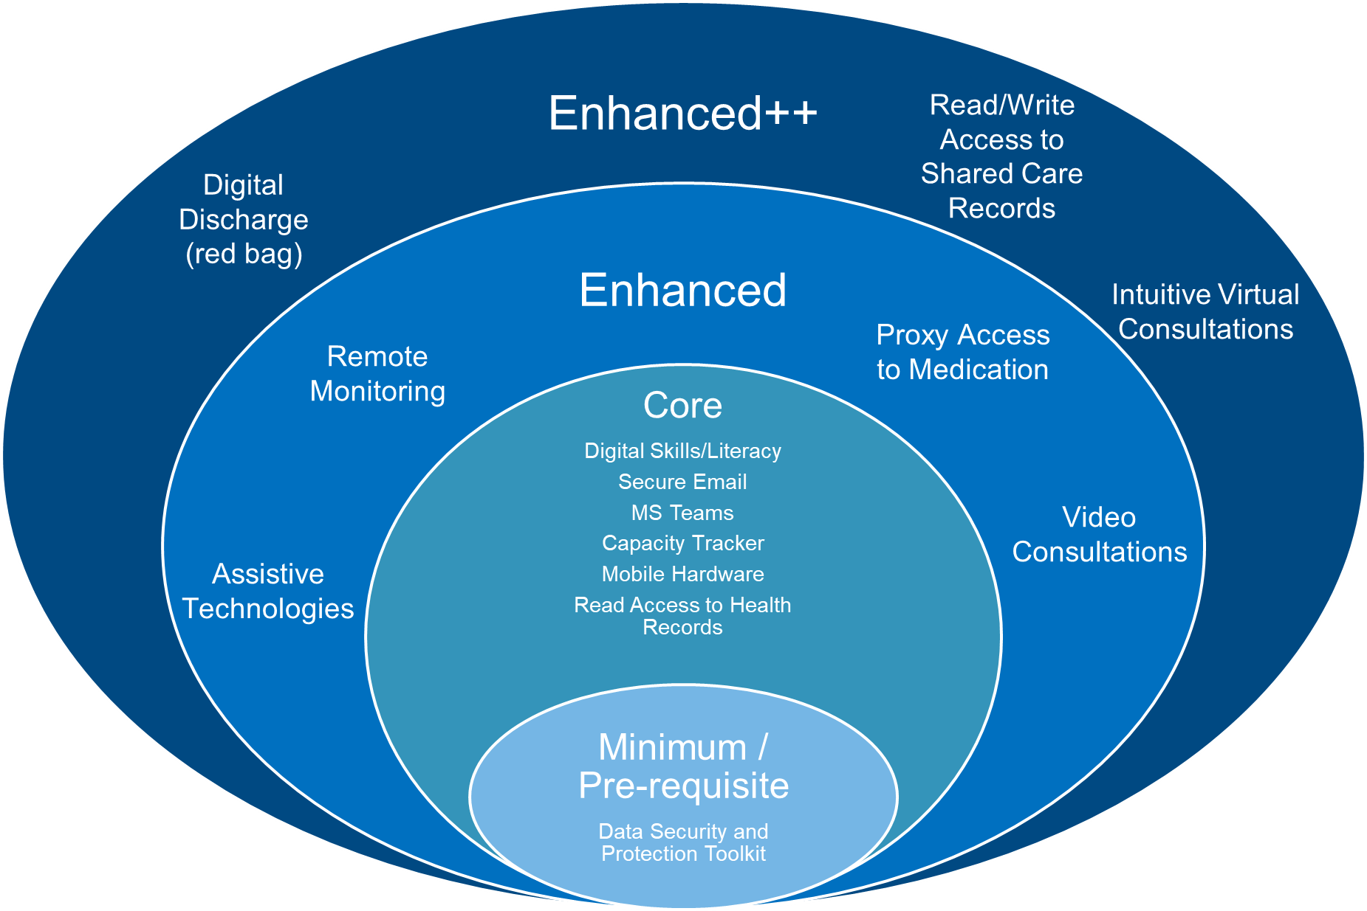
Digital Social Care Journey – ensuring an equitable approach
Enhanced ++
Ensuring IG is in place as well as training needed for care home staff to deliver digital tools
Enhanced
Ensuring alignment with national deliverables and offers
Core/Minimum
Ensuring core equitable offer across all SE Region care homes is met

Slide 5
Step 1
Understanding the home’s current DSPT status
Action Required
Guidance and support available
No Status The home has not registered for the DSPT
→
Continue to Step 2. Register on the DSPT website, complete and publish the toolkit to minimum standard https://www.dsptoolkit.nhs.uk
Not published The home has registered for the DSPT but not published the assessment
→
Continue to Step 3.Complete and publish the toolkit to minimum standard https://www.dsptoolkit.nhs.uk/Account/Login
Guidance is available from
NHS Digital and Digital Social Care
Digital Social Care Helpline
T: 0208 133 3430 or email help@digitalsocialcare.co.uk.
Please contact your local DSPT Lead to access further support
20/21 Entry Level No longer available
→
Continue to Step 3. Review assessment, complete an improvement plan and republish at Approaching Standards or Standards Met before 30th June 2021 https://www.dsptoolkit.nhs.uk/Account/Login
→
Approaching Standards New status
This level is not available until March 2021 date
Continue to Step 3., Complete assessment and an improvement plan and publish at Approaching Standards before 30th June 2021 https://www.dsptoolkit.nhs.uk/Account/Login
→
Any status pre 20/21 Entry Level or Standards Met
→
Review assessment, complete an improvement plan and republish at Approaching Standards or Standards Met before 30th June 2021 https://www.dsptoolkit.nhs.uk/Account/Login
20/21 Standards Met/Exceeded Standards
→
No further action required this year

Slide 6
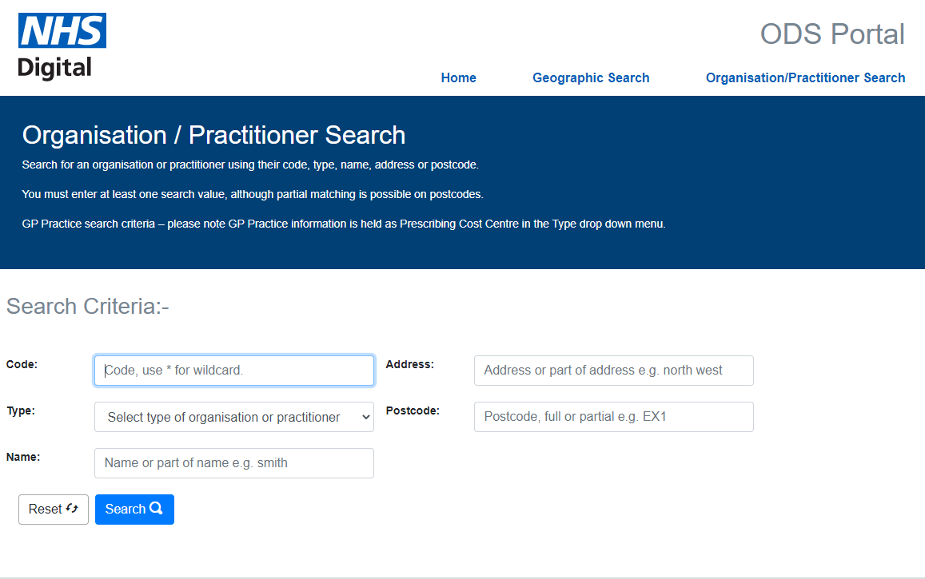
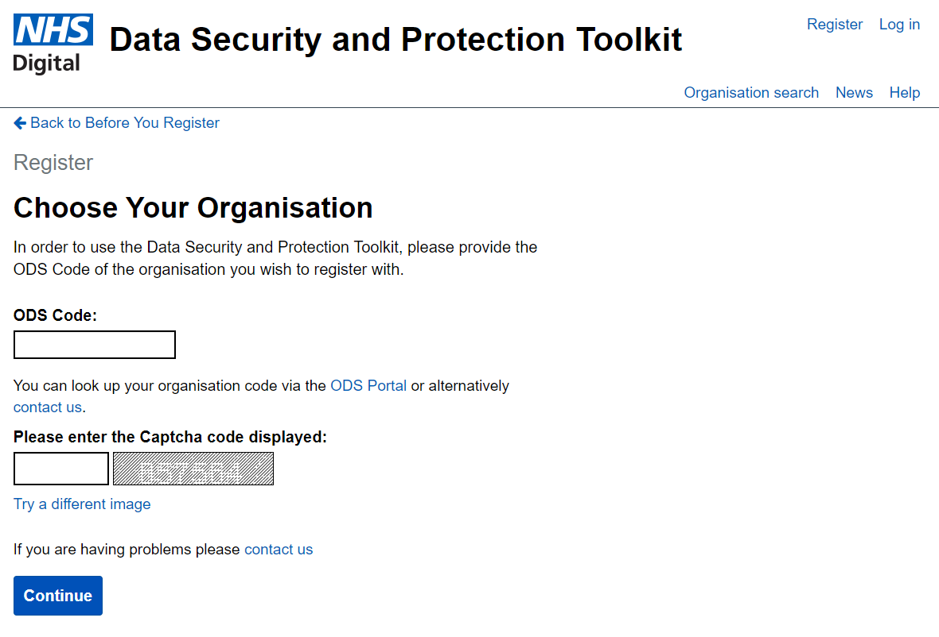
Step 2
Finding your ODS code and registering for DSPT
https://odsportal.digital.nhs.uk/Organisation/Search
https://www.dsptoolkit.nhs.uk/Account/RegisterOrganisationCode
You will then be sent an email containing a link which you click on and it takes you back to the registration page for you to set up your password.
Once your password is set, you and your organisation are registered and will be able to start your assessment. This is all you need to do to register

Slide 7
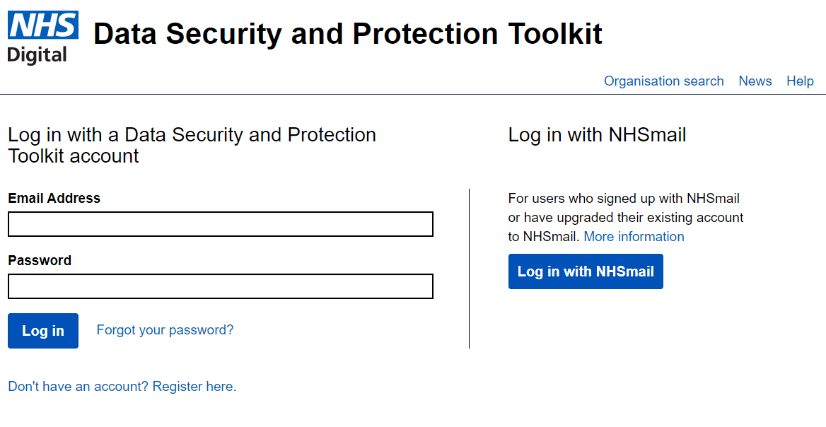
Step 3
Complete the DSPT
Register with the Information Commissioners Office (ICO) – care homes are expected to have ICO membership.
Link to pay fee, renew fee or register: https://ico.org.uk/
If you are already registered – skip to next step

Slide 8
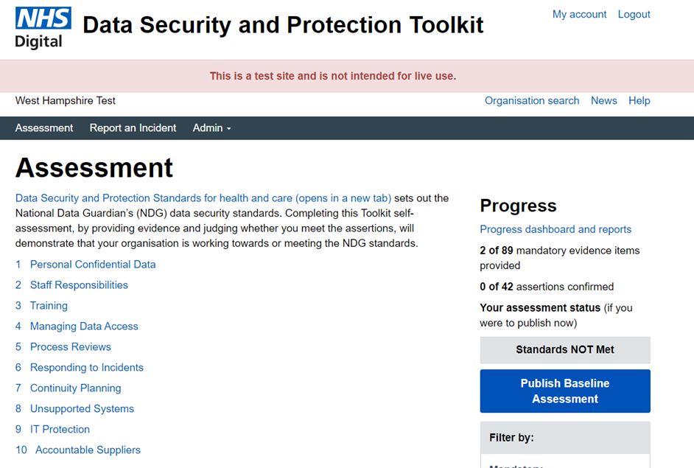
Step 3
Complete the DSPT
Action Required
Guidance and support available to complete the DSPT
Complete the DSPT.
Guidance is available from NHS Digital and Digital Social Care
DSPT FAQs
DSPT Overview
Digital Social Care Helpline
T: 0208 133 3430 or email help@digitalsocialcare.co.uk.
Link to:
Free data security awareness training
.
DSPT Standards Met Guide This goes through the 10 standards in detail and shows you what you need to do to meet each standard that is relevant to care homes
DSPT webinars these webinars provide information and support on how to register, data security, policies and procedures for better security, data protection and cyber security training and protecting IT systems and devices from cyber threats.
Publish DSPT assessment
Continue to NHSMail application

Slide 9
What is NHS Mail ?
NHS Mail is a secure email service which gives care organisations the ability to safely share residents’ information with doctors, nurses, GPs and other professionals involved in their resident’s direct care.
Action Required
DSPT waiver in place until 30th June 2021. Fast track application available Fast Track Process
Guidance and support available
Step 1
Publish Data Security and Protection Toolkit (DSPT)
Minimum standard Jan to Jun
Register on the DSPT website, complete and publish the toolkit to minimum standard https://www.dsptoolkit.nhs.uk
Guidance is available from NHS Digital and Digital Social Care
Digital Social Care Helpline
T: 0208 133 3430 or email help@digitalsocialcare.co.uk
.
How to complete the NHS mail Social Care Registration
NHSmail Care Provider User Guide.pdf
Helpdesk T:0333 200 1133
Email careadmin@nhs.net
→
Step 2
Register for an NHS mail account
https://portal.nhs.net/Registration#/careprovider
You will need the following to complete this step
CQC Location ID
CQC Manager’s ID
ODS Code
Each site receives:
Maximum 10 individual linked user accounts
1 shared mailbox (care.odscode@nhs.net)
→
Step 3
Activate the account
→
Follow the instructions contained in the welcome email to activate the account
Ensure you log into the account regularly to keep it active
Forgotten Passwords
Reset online or phone the helpdesk
T:0333 200 1133

Slide 10
Digital Social Care Support katie@digitalsocialcare.co.uk / @DigiSocialCare

Slide 11
What is Digital Social Care?
A partnership project between members of the Care Provider Alliance and Skills for Care – funded by NHS Digital and NHSX
By social care providers for social care providers
Dedicated space for free information, support and guidance on information sharing and technology
www.digitalsocialcare.co.uk

Slide 12
What support do we offer - generally
Telephone helpline and email service
Guides – video and text
Digital Readiness Tool
Success Stories
Newsletter
Funding
Glossary / Jargon Buster
Our helpline is open between 9am and 5pm Monday to Friday by calling 0208 133 3430 or by email on help@digitalsocialcare.co.uk

Slide 13
What support do we offer
https://www.digitalsocialcare.co.uk/data-security-protecting-my-information/data-security-and-protection-toolkit/
Helpdesk / knowledge base
How to Guides and workbooks
Standards Met
Approaching Standards (forthcoming)
Videos
How to register
Template policies & Procedures
Staff Guidance
Large Provider Support
Central contact with and support to larger providers who work nationally or across several regions.
DSPT Auditing
Anonymous sampling of some submitted toolkits.

Slide 14
What support do we offer
NHSmail
Host videos and guides created by NHSmail / Accenture
Information on how to sign up for NHSmail
Information on secure email accreditation
Care Home iPads
Host videos and guides on how to use the iPads including
How to change a passcode
How to access NHSmail
How to use MS Teams
NHSmail movers and leavers policy
Host weekly webinars with live Q&A for care homes

Slide 15
5 mins for feedback forms to be completed https://www.menti.com/44wndida3b Questions
Notes:
https://www.menti.com/44wndida3b

